Slide 1

Architecture in the Cloud
https://commons.wikimedia.org/wiki/File:Above_the_Clouds.jpg

Slide 2
Origin of the term “Cloud Computing”
First cloud image usage – around 1980s
  TCP/IP / networking / package abstraction
  Send to the network, it arrives, don’t care about in-between
  Network diagrams drew this undetailed part as a literal cloud shape – that icon is where the name comes from
Second incarnation – early 1990s
  Data / document storage / source abstraction
  Download a document, don’t care where it was stored (from the web / intranet)
Third wave – from 2000s
  Infrastructure abstraction
  Host a software system, don’t care where & how
  Work on business value instead of infrastructure
Same icon, three abstractions later: “the cloud” became the name for anything you don’t need to see behind the interface
Notes:
Jeff Bezos’ quote: http://news.cnet.com/8301-13953_3-9977100-80.html?tag=mncol
Kevin Marks quote: http://news.cnet.com/8301-13953_3-9938949-80.html?tag=mncol video interview

Slide 3
What is Cloud computing?
On-premise
  We need to scale – timeline: weeks to months
    Choose hardware & supplier
    Order hardware
    Wait for delivery, install, & setup
  We don’t need that hardware anymore
    Nah, live with it now
Cloud
  External compute resources (nothing is owned)
  Temporary access (rent)
  Limited control
  Highly scalable – timeline: seconds to minutes
  Pay for what you use (instead of buying assets)
Notes:
To a degree, cloud computing owes a lot to the dot.com bubble – it built the infrastructure that allowed the internet to become ubiquitous and provide the bandwidth for concepts like cloud computing to grow.
Another founding principle was COTS hardware. The ability to quickly and cheaply source hardware and the fact that it was all the same created a cost effective compute platform to support cloud computing.

Slide 4
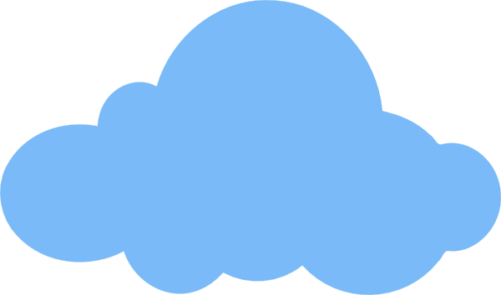
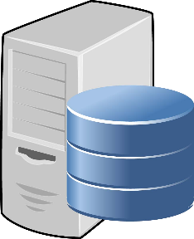

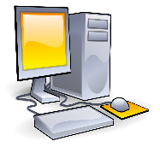

A shift …
On Premises
ASP1
ASP2
ASP3
Elastic, Multi-tenant Cloud
Distributed, autoscaling, provider managed
Cluster
Load balancing, replication, availability, dynamic allocation, self-managed
ASP = Application Service Provider
Notes:
1 server, scaling – buying more powerful HW
Cluster – load balancing, replication, availability, dynamic allocation
high initial cost (need to by in advance)
need to manage everything
Cloud – infra owner owns let multiple tenants in
distributed
autoscaling
managed by a provider

Slide 5
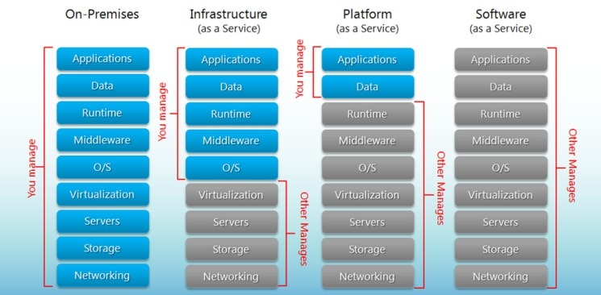
Cloud Service Models
Cloud Infrastructure as a Service (IaaS)
  Rent processing, storage, network capacity, and other fundamental computing resources
    e.g. AWS EC2
    use case – you don’t want to buy & maintain HW, but need full control
Cloud Platform as a Service (PaaS)
  Deploy customer-created applications to
  a cloud
  Provides platform (OS, storage,
  availability, JVM, Node, etc)
    e.g. Google App engine, PHP hosting,
    Microsoft Azure App Service
Cloud Software as a Service (SaaS)
  Use provider’s applications over a
  network
  Cannot change anything
    e.g. Gmail, Office 365, Dropbox
https://www.bigcommerce.com/blog/saas-vs-paas-vs-iaas/#the-key-differences-between-on-premise-saas-paas-iaas

Slide 6
Mutant Cloud Service Models
Container as a Service (CaaS)
  Deploy a Docker container
    e.g. AWS EKS / ECS
  Not PaaS
    Have to manage
      Frameworks / runtime environments (Node, etc)
      Dockerfile, dependencies
      Networking (VPC, subnets, etc)
      IAM, secret management
      Auto-scaling policies
  Not IaaS
    No access to
      OS & packages & low-level config & security
      SSH
      reboot
CaaS
https://www.bigcommerce.com/blog/saas-vs-paas-vs-iaas/#the-key-differences-between-on-premise-saas-paas-iaas

Slide 7
Mutant Cloud Service Models
Function as a Service (FaaS)
  Deploy a function
  Not PaaS
    No long-running services
    No persistence
    Ephemeral
Salesforce, etc
  PaaS + SaaS
  Depends on how you use it
    CRM – SaaS
    Custom code / app platform – PaaS
[X]aaS
  A lot – derivatives, subtypes, nuances
  e.g. managed MySQL – what is it?
FaaS
https://www.bigcommerce.com/blog/saas-vs-paas-vs-iaas/#the-key-differences-between-on-premise-saas-paas-iaas

Slide 8
Cloud Service Models
Why it matters
  Control
    What do you need or want to control – for legal, compliance, or competitive reasons?
  Responsibility separation
    Whatever you keep control of, you need the in-house expertise to run it
  Scalability
    What can you scale, and what do you need to scale?
    Ties back to expertise and control – more ownership means more to manage as you grow
    And how fast can you scale when demand changes?
  CAPEX vs OPEX
    Buying hardware upfront vs. paying only for what you use

Slide 9
CAPEX and OPEX Defined
CAPital EXpense
  Asset is "owned"
  One time purchase
  Business finance benefit: Costs can be capitalized and amortized (depreciated) over the asset’s useful life
  The owner is responsible for ongoing maintenance
OPerational EXpense
  No ownership of asset
  You pay for Costs of Usage (aka Operation)
  When operation ceases, so does your expense
  Fully expensed in the year it’s incurred – no amortization
  Business finance benefit: no big upfront investment, easier budgeting, and cost scales with actual usage instead of sitting idle

Slide 10
Visually …
Cloud Infrastructure
SaaS
PaaS
IaaS

Slide 11
Cloud Deployment Models
“The cloud is just someone else’s computer” © somebody on the Internet
  WHERE can be important
    Security, flexibility, legal, control, etc
There are multiple deployment models to fit business needs
  Public Cloud
    For the masses
    Multi-tenant – shared infrastructure
    Almost endless scalability
    Fast provisioning
    Pay-as-you-go
    Use cases
      Companies with spiked load
  Private Cloud
    Enterprise owned, but using Cloud Technology
    Can be local, or remote (but segregated)
    Mini-AWS/Azure/GCP within one company
    Single-tenant
    Full control & customization
    Data sovereignty / strict compliance
    Past cost inflection point
    Use cases
      Large corporation with multiple departments / teams

Slide 12
Cloud Deployment Models
  Hybrid Cloud
    Part is private, part is public
    Use cases
      Sensitive data is in a private cloud, the rest is in a public one
        e.g. PII & credit card data in a private cloud, a website in a public one – Walmart
      In transition
        e.g. migration from a private cloud to a public one – can take years
      Cost optimization
        e.g. keep steady-state workloads on cheaper private infrastructure, burst to public cloud only for peak spikes

Slide 13
The NIST Cloud Definition Framework
Hybrid Clouds
Deployment
Models
Private Cloud
Community
Cloud
Public Cloud
Service
Models
Software as a Service (SaaS)
Platform as a Service (PaaS)
Infrastructure as a Service (IaaS)
On Demand Self-Service
Essential
Characteristics
Broad Network Access
Rapid Elasticity
Resource Pooling
Measured Service
Massive Scale
Resilient Computing
Common
Characteristics
Homogeneity
Geographic Distribution
Virtualization
Service Orientation
Low Cost Software
Advanced Security
Notes:
Community – shared across several similar organizations (e.g., computing cluster created & shared by research institutes)
Resource pooling – dynamic tenant allocation, location independent
Measured service – measuring on multiple levels (pay-as-you-go requires)
Homogeneity – standardized HW & SW
Service oriented – everything is a service (available through API)
Cloud diagram idea inspired by Maria Spinola 8-31-09

Slide 14
Cloud Revenue Models
CAPEX → OPEX shift
Common revenue models for [X]aaS
  Charge per unit of ‘consumption’
  Charge per component (or feature/ feature set) per unit of time
  Charge per user per unit of time
All tend to be "per unit of time (N)" where N is typically a time-based factor
  Granularity varies by service and provider
  Raw compute (e.g. AWS EC2 Linux) often bills per-second
  Managed / subscription services still bill by hour, day, or month
  The longer the commit, the cheaper the resource
    e.g. AWS Reserved Instances (1–3 yr commit) vs. On-Demand pricing – committing longer can cut compute cost by 40–60%

Slide 15
Model vs Adoption
Charge per unit of consumption
  Usually done for Infrastructure-as-a-Service
    e.g. Bandwidth (kb/month); CPU (unit/hour), storage (mb/hour)
    Discrete (bytes, operations, etc)
    Controlled & measured by the provider
    But require efforts to setup tools & find the optimal pricing
    e.g.
      Hypervisors track CPU utilization
      Storage clusters / devices track block storage
      Network gateways / devices track packets & bytes
Charge per component or feature set (per month or other)
  Commonly used for Software-as-a-Service
    Low cost of entry for small set of features
    Allows:
      Customer to “try at low cost” before they fully commit
      Provider to onboard and prove value earlier / faster, and to cover different types of customers
    Up-sell after customer shows satisfaction

Slide 16
Model vs Adoption
Charge per user per month (or other unit of time)
  Commonly used for Software-as-a-Service
  Frequently used in combination with "feature bundles"
  Logical and understandable to customers
  Allows revenue to scale as more adoption occurs
  Fairly easy to track & bill
  e.g. Slack - ~$5-$20 per user
    But large companies negotiate discounts

Slide 17
Examples
IaaS Providers
  e.g. Amazon, Microsoft, Google
  You pay for:
    Service Instance
    Network packets in/ out
    Additional modules/ functions
PaaS Providers
  e.g. Heroku, Salesforce Platform, IBM Cloud Foundry
  You pay for:
    Managed runtime & platform
    Deployment / scaling automation
SaaS Providers
  e.g. Netflix, Spotify, Adobe
  You pay for:
    Membership
    Tiers of service
IaaS and PaaS are very intertwined
… most situations end up as PaaS
… unless you purchase pure IaaS and install / manage OS and Applications on your own ("bare" VM / Server)

Slide 18
Challenges for Cloud Adoption
Many challenges have been overcome with time, but the common concerns remain
  Security
    Not fully controlled by you
    Complex → misconfigurations
  Performance
    Shared → no 100% guarantee
    Some (high-frequency trading, real-time systems, etc) software require more
  Availability
    Datacenters and regions can go down → need to design for this
  Integration (with other systems)
    e.g. legacy on-premise systems
  Customizability (limited)
  Cost
    CAPEX/OPEX trade-offs
  Loss of control
    e.g. cannot fix everything by yourself, can be kicked out

Slide 19
Challenges for Cloud Adoption - Cost
Cloud is cheaper! It's not that simple…
  Quick and low-cost start – cloud
  Unpredictable high spikes of workload – cloud
  Fast grow & scaling – cloud
  No expertise in hardware – cloud
  Stable workload / stable grow – not that obvious
At some point – typically once a steady, predictable workload has run for a few years – the amortized cost of owning a datacenter / on-premise infrastructure undercuts the cloud’s ongoing OPEX

Slide 20
Challenges for Cloud Adoption - Cost
Compute
  Number of instances
  Instance type (memory, GPU, etc)
  vCPU count & speed
  RAM
  Architecture
  Runtime duration
  Autoscaling policies
  Commitment
  = 8+ factors
Any cloud – 200+ products
200+ * 8+ = 1600+ combinations
      * different ways of use
      * fluctuations in traffic & client behavior

Slide 21
Cloud Repatriation
Regain control
Control costs
Optimize long-term cost
Avoid vendor lock
Some companies
  Dropbox (first major, 2016)
  Twitter / X
  GitLab
  DigitalOcean
  InfluxData
  Backblaze
  37Signals/Basecamp
80%+ CIO plan to move at least some part of their IT landscape from clouds – 2024, Wayback Machine

Slide 22
Emerging Service Models
Heterogeneous computing – the cloud becomes a much richer environment with a wider selection of resources available.
  Acceleration as a Service
    Cloud Providers move from generic hardware to a richer variety of hardware accelerators – GPUs, FPGAs, and custom ASICs such as Tensor Processing Units.
    Driven mainly by AI/ML training and inference demand – e.g. AWS Trainium/Inferentia, NVIDIA H100/A100 GPU instances
  Container as a Service
      The basic resource becomes a container as opposed to a virtual machine e.g. Docker
  Function as a Service
      Serverless computing – resources are only used on-demand to run a function. There is no VM being held by the user. e.g. Lambdas

Slide 23
Emerging Deployment Models
Micro-Cloud
  Cloud deployed on-site (factories, retail stores, ships, oil rigs, etc)
  When latency is critical (yes, edge computing)
    e.g. AI inference at the edge – autonomous vehicles, industrial IoT, real-time vision
Ad-Hoc Cloud
  Users/organizations make available underutilized resources.
    Social Cloud computing – users interested in a cause share resources
    Volunteer computing – owners make available their extra-capacity with no guarantees of long-term availability
    e.g. SETI@home – analyzing radio telescope data for signs of extraterrestrial intelligence
    Modern parallel: decentralized GPU marketplaces (Akash, Render, io.net) monetizing idle GPUs for AI training/inference
    Issues:
      Security
      Device entering and leaving at random points in time
      Compensation for usage, energy, cell data, etc

Slide 24
Continued Evolution of Computing
Centralized mainframes smaller department computers desktop models
Cloud computing reversed this trend pushing for consolidation of resources
  Addressing issues of cost and maintenance.
Servers Cloud computing
New models are now evolving that push processing from the cloud back closer to the user.
Cloud computing Edge computing
Mobile phones are still underutilized
Can this resource be leveraged?
Already happening (2026): Nvidia, Span, and PulteGroup are bolting micro-data-center “XFRA” nodes onto new homes, tapping idle residential electrical capacity for distributed AI compute – 80,000 nodes planned by 2027 (1+ GW of distributed capacity)

